Slide 1
Optimization Update and EIS Testing Ideas

Slide 2
Optimization stuff done
Downloaded Matlab-Optimization + supporting files necessary for running the optimization, got Knitro working. Working in the humanoid-planar-jump branch.
Learned how the code works and how to modify it. Also learned about Matlab OOP.
Updated battery specific constraints for SIMPLE IR
Minimum cell voltage <- toughest constraint for what we are doing
Max pack current
Max pack power
Max joint speeds
Adding graphing abilities for relevant battery quantities.

Slide 3
Simple IR model
Simple IR model for the dynamics of the battery does not require any modifications to decision variables which made it quick to implement. Simple IR is not even a first order system.
Can solve for pack voltage with nothing other than system parameters and power demanded at that instant.
Should give reliable way of predicting if certain maneuvers are within the capabilities of the battery.

Slide 4
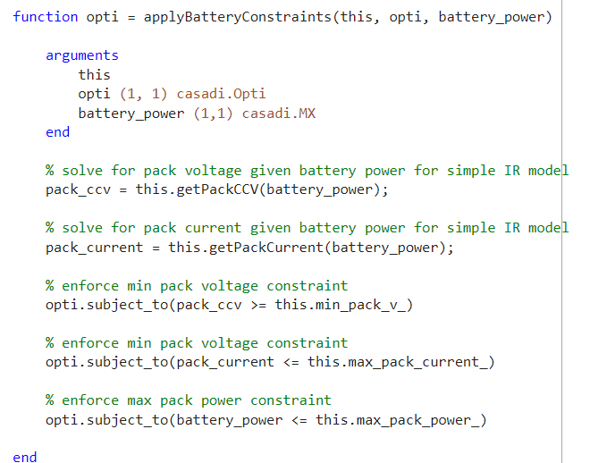

Slide 5
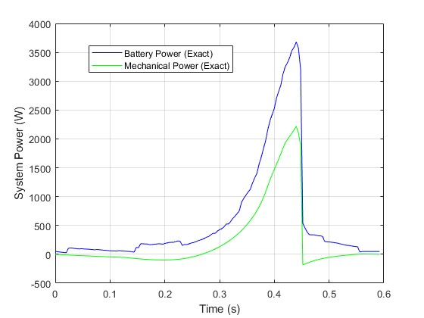
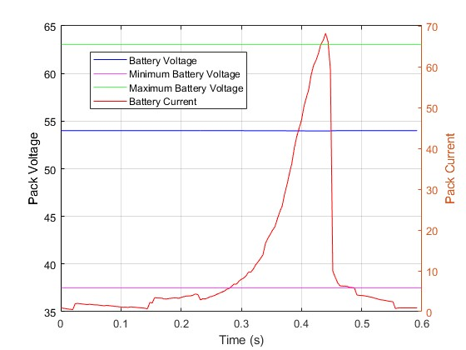
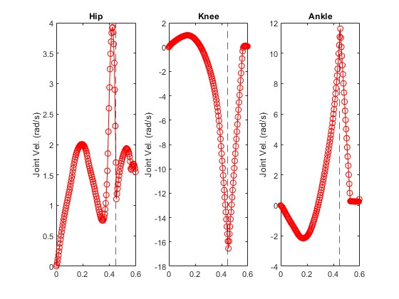
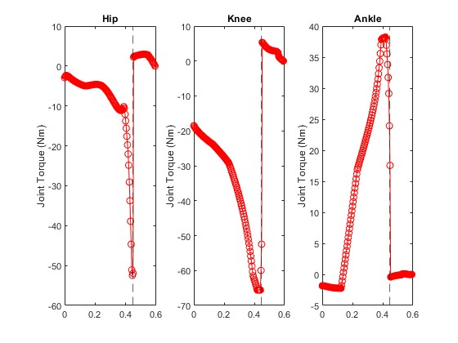
Graphs (cell_IR = 0mΩ)

Slide 6
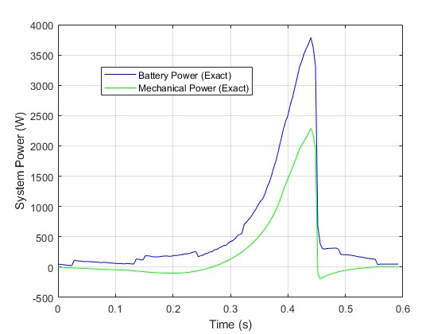
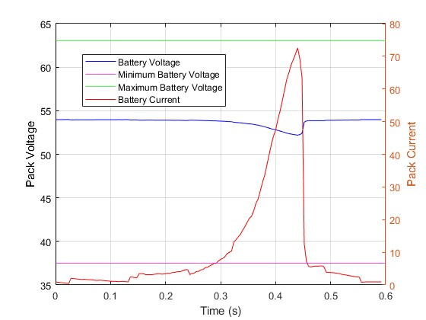
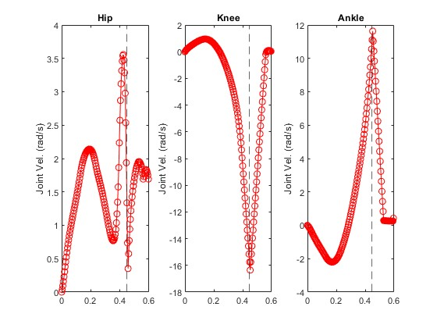

Graphs (cell_IR = 5mΩ)

Slide 7
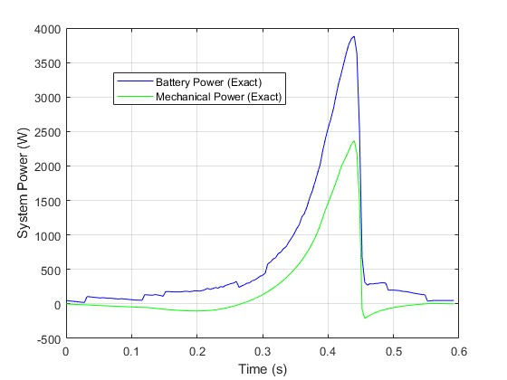
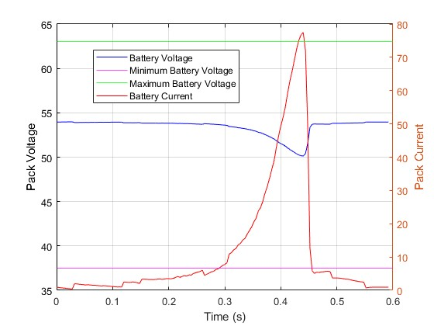
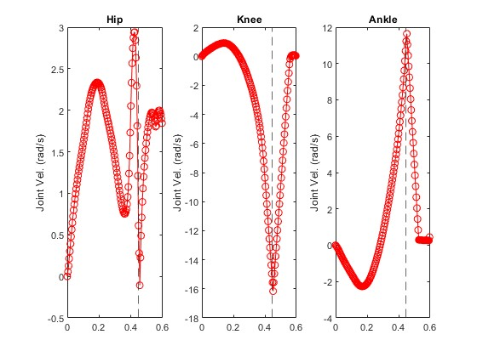

Graphs (cell_IR = 10mΩ)

Slide 8
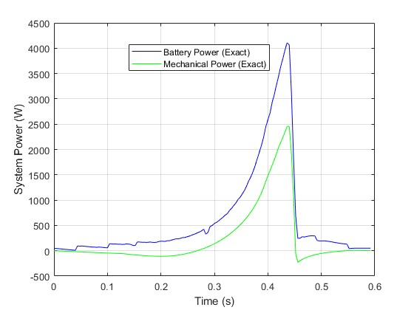
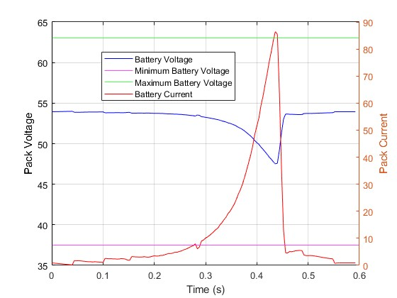
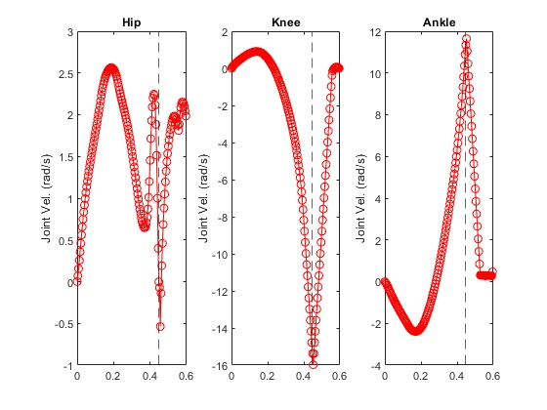
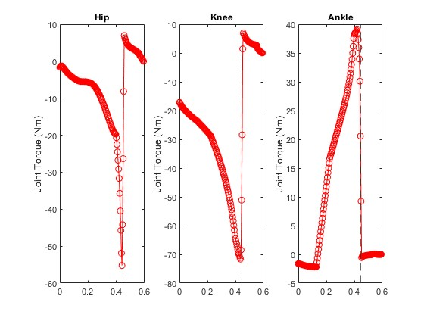
Graphs (cell_IR = 15mΩ)

Slide 9
Abilities of Modeling with Simple IR
Changing the IR of the cell used does not change the trajectory of the humanoid, rather determines if solution can be found or not.
Cost function already sums the squares of joint speeds and torques.
IR = 15mΩ is the limit for the planar jump of 1m before solution is not found.

Slide 10
Stuff left to do for optimization
Working on implementing Randles model. This is inherently more complex for multiple reasons.
Equations to solve for battery voltage and current now depend on the history of the system, which is encapsulated in the stored charge in the charge transfer capacitor of the Randles model.
Requires a decision variable that is the charge transfer capacitor’s charge at every time step.
May require and integer multiple of timesteps compared to robot trajectory.
Working on adding the ability to include different battery models as a class and to select between them. Requires code restructuring.

Slide 11
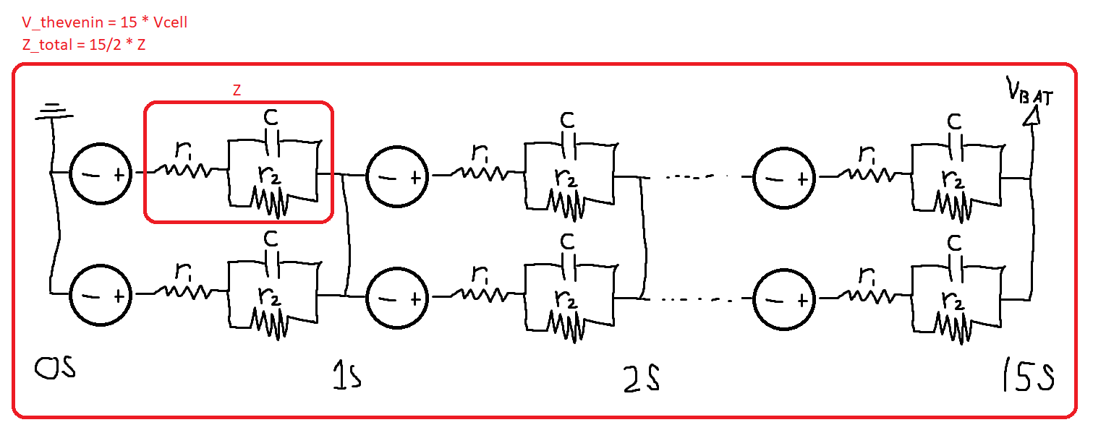

Slide 12
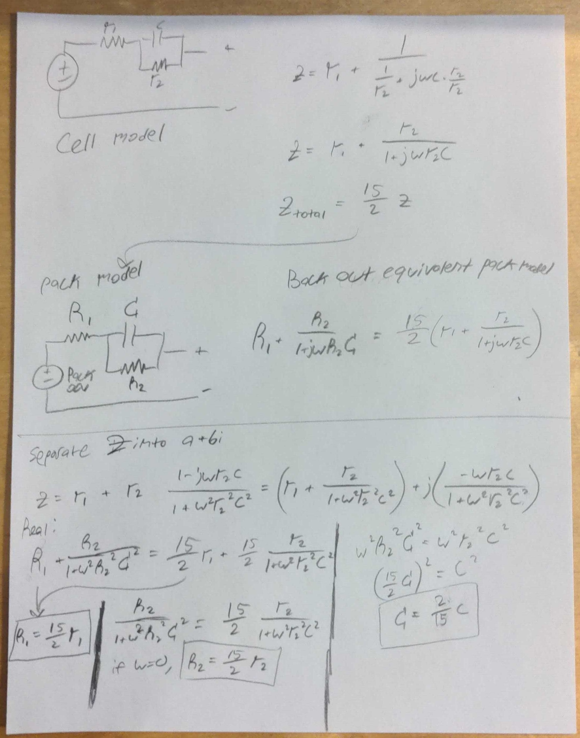

Slide 13
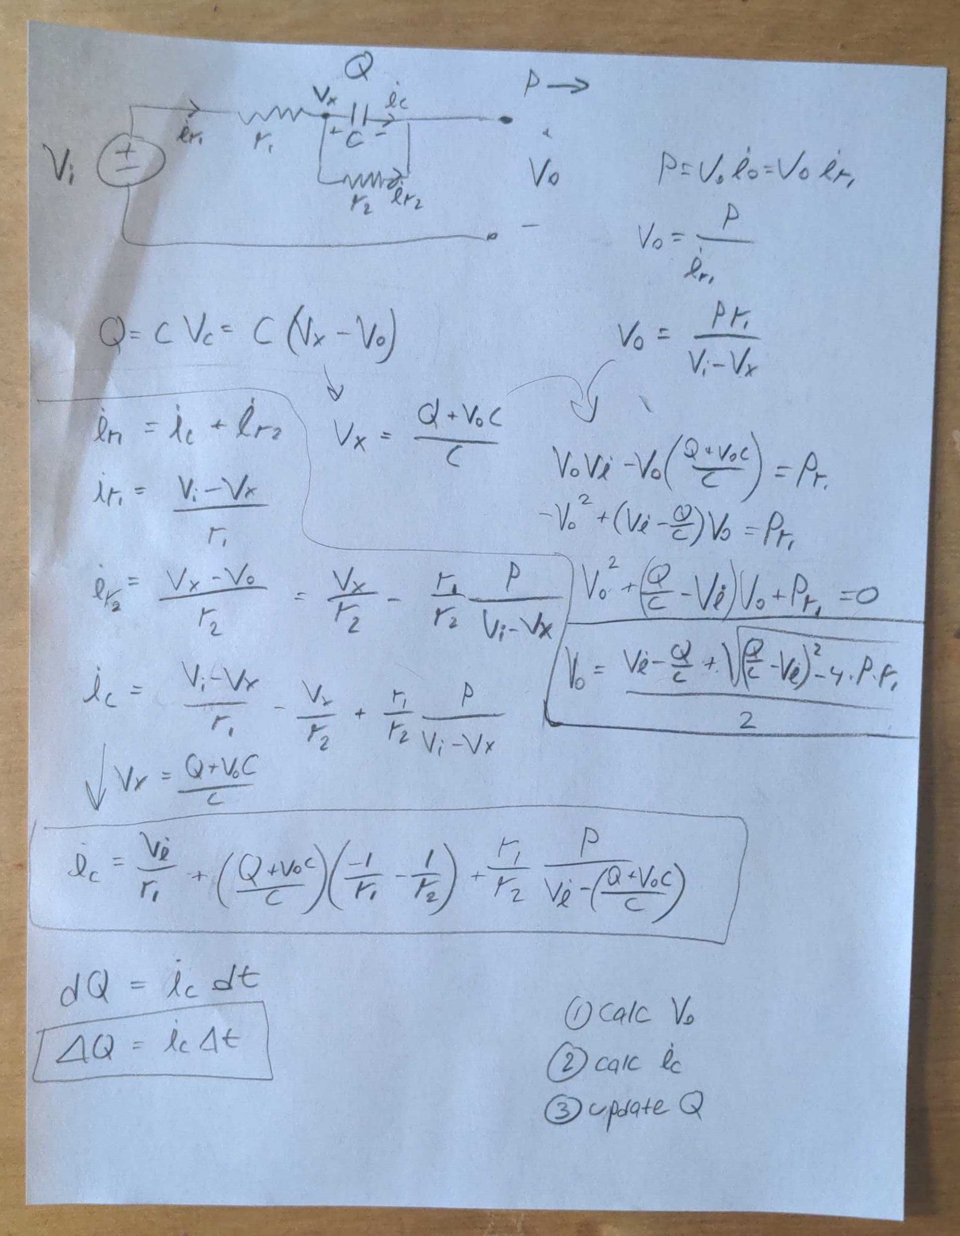

Slide 14
Poor Man’s EIS
Would be very nice to do some in house testing that is cheap and sufficient for the modeling we want to do.
Normally, EIS testing of a battery cell gives a complex impedance for a range of frequencies, and a NLL squares algorithm is used to fit the behavior to any arbitrary model. Since we are trying to fit the simple Randles model which is only a first order system, other methods can be explored to back out the internal parameters of the cell.
A step by step process for populating the Randles model with parameters could be as follows:

Slide 15
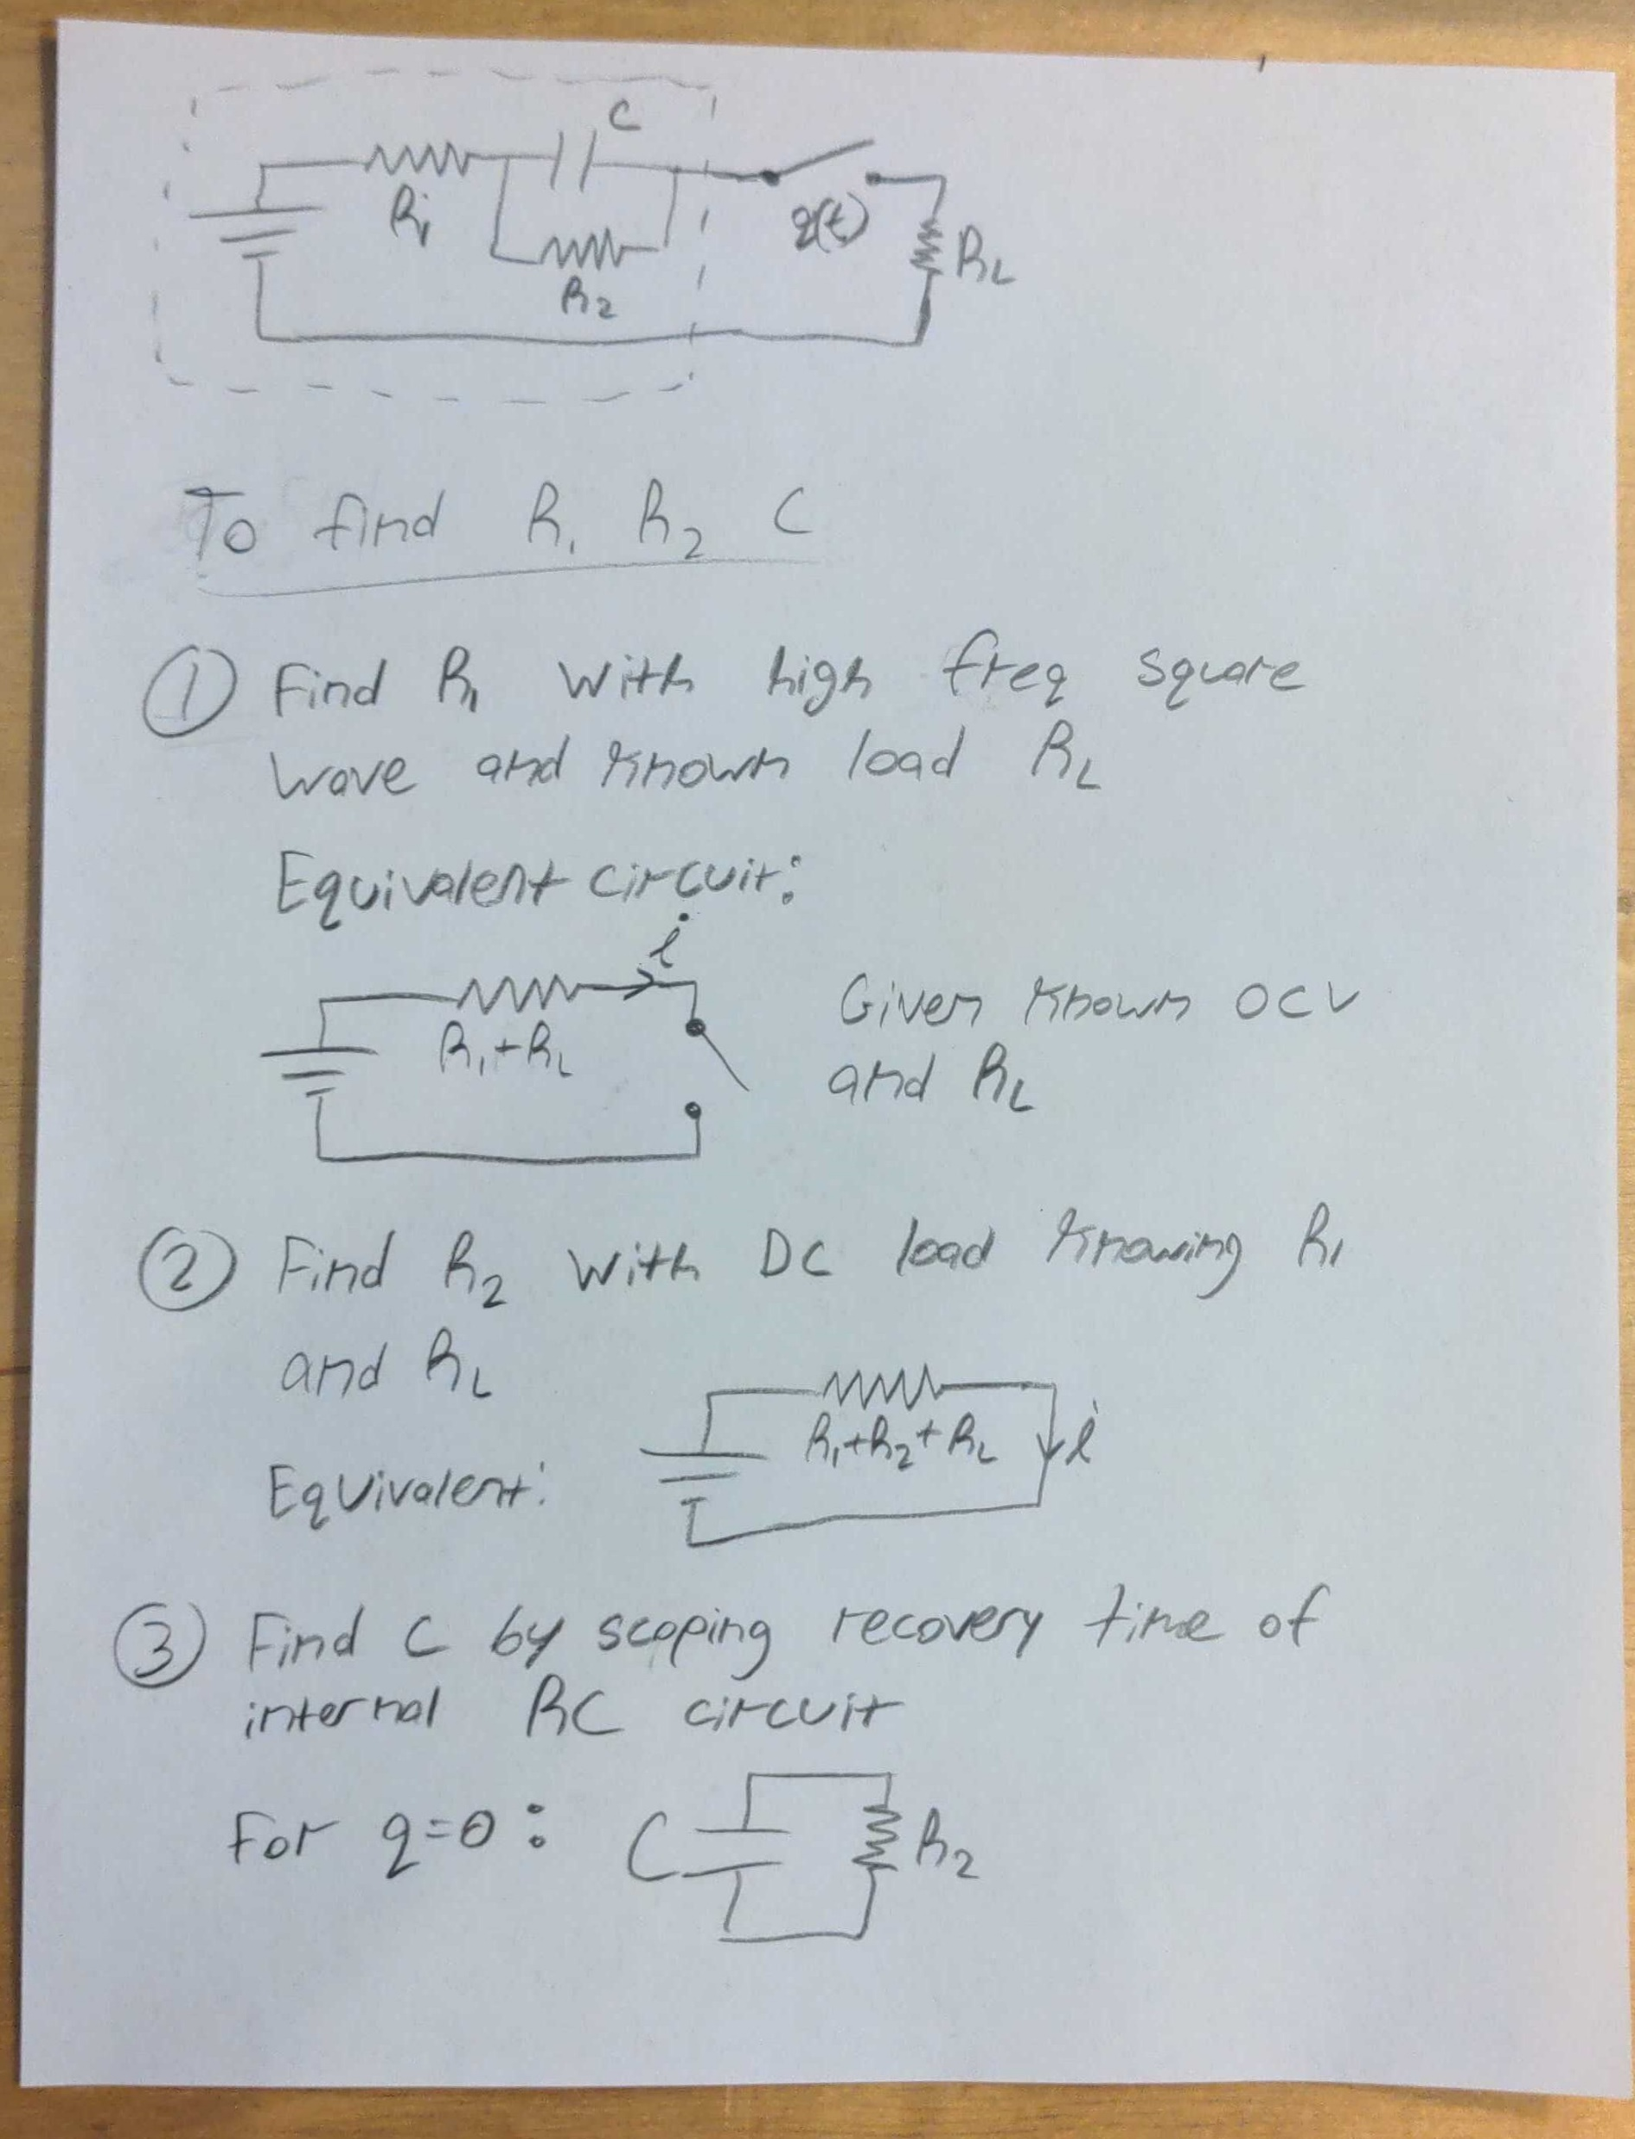

Slide 16
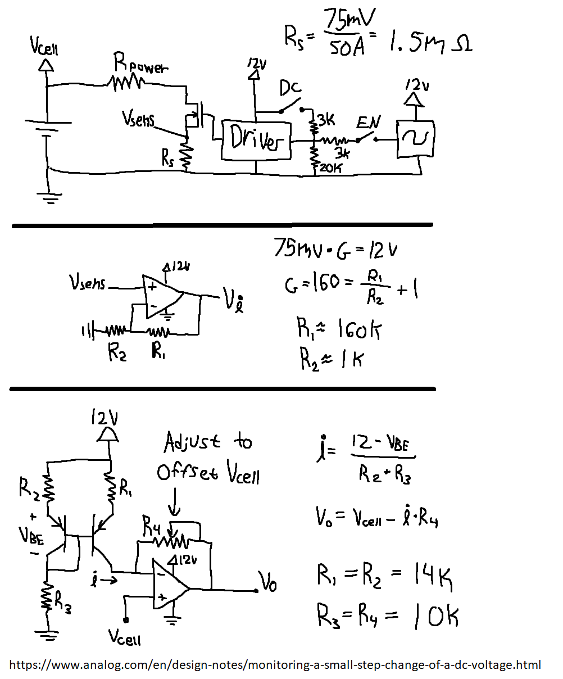
Proposed Load Circuit

Slide 18
In order to measure the small voltage changes of the cell voltage under load (~1V max @ 40A for a cell like the 40T), an adjustable subtractor circuit is used to bring the cell voltage down closer to zero. This would increase the signal to DC bias ratio and allow an oscilloscope to make more accurate measurements of the internal RC time constant.

